Slide 2
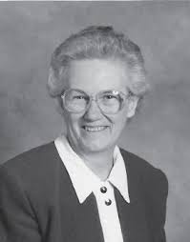
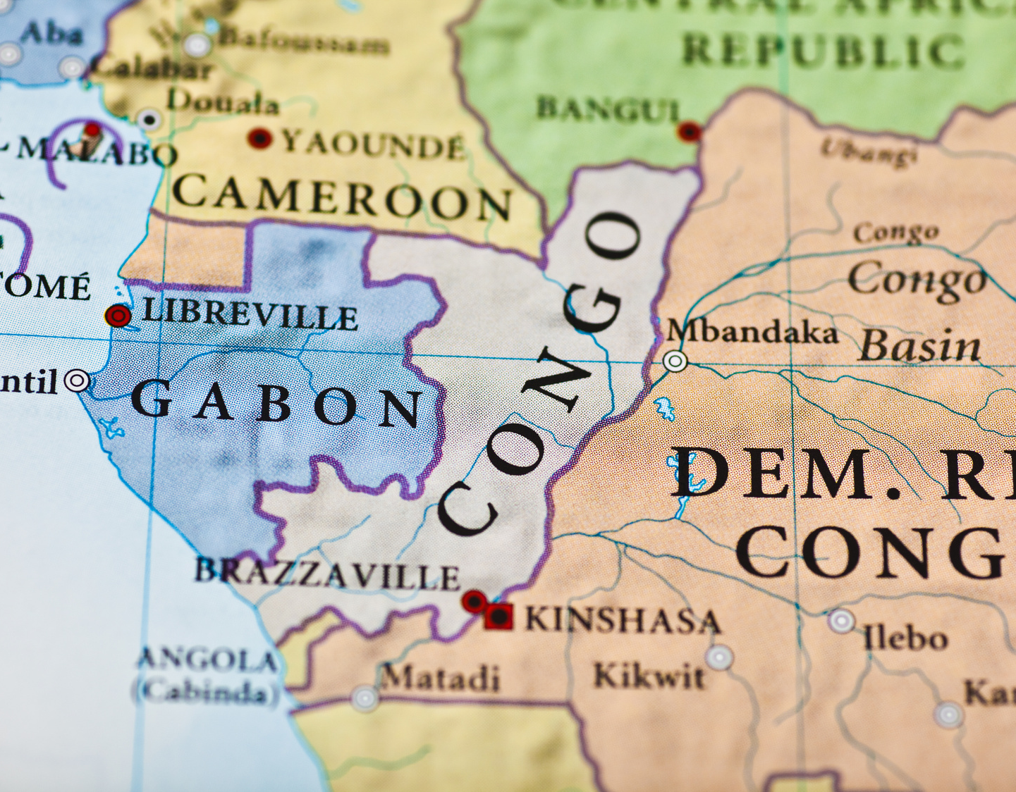
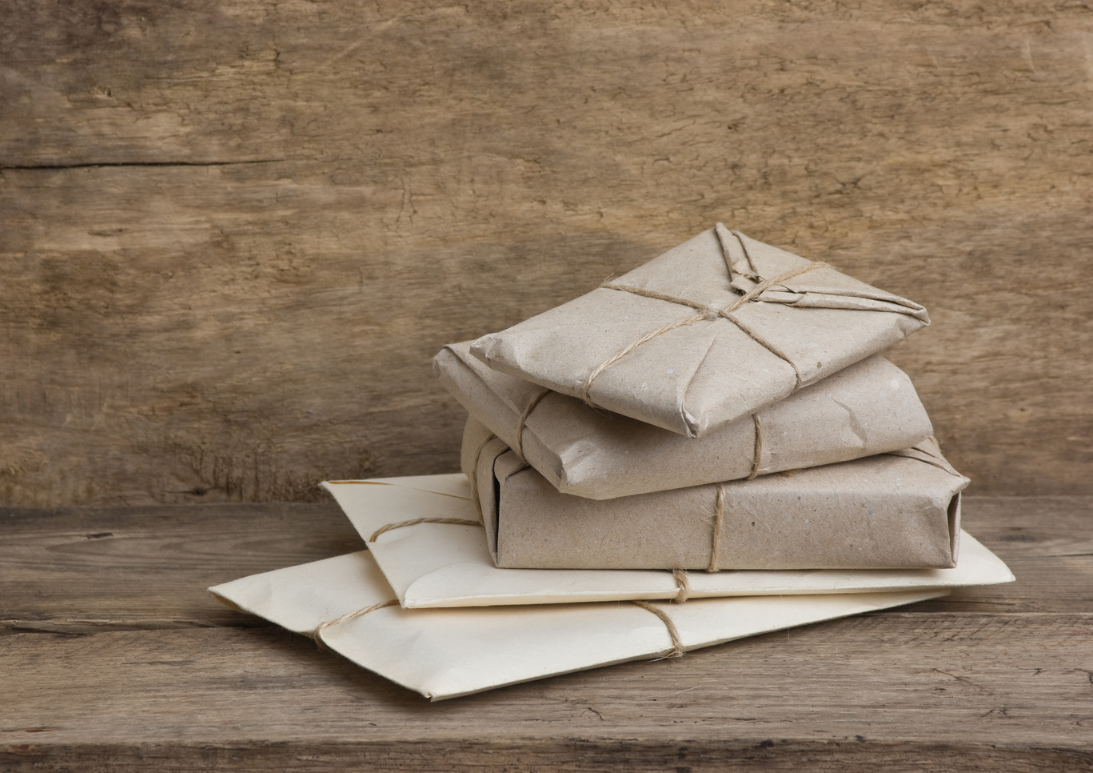
The Hot Water Bottle Story
Notes:
This is a true story about Helen Roseveare when she worked in the Congo as a doctor. You can find the full story in the notes.
A small book is available if you want to purchase:
Title Helen Roseveare: What’s In The Parcel?
Author(s) Catherine Mackenzie
ISBN 9781845503833
Publisher Christian Focus Publications
Series Little Lights

Slide 3
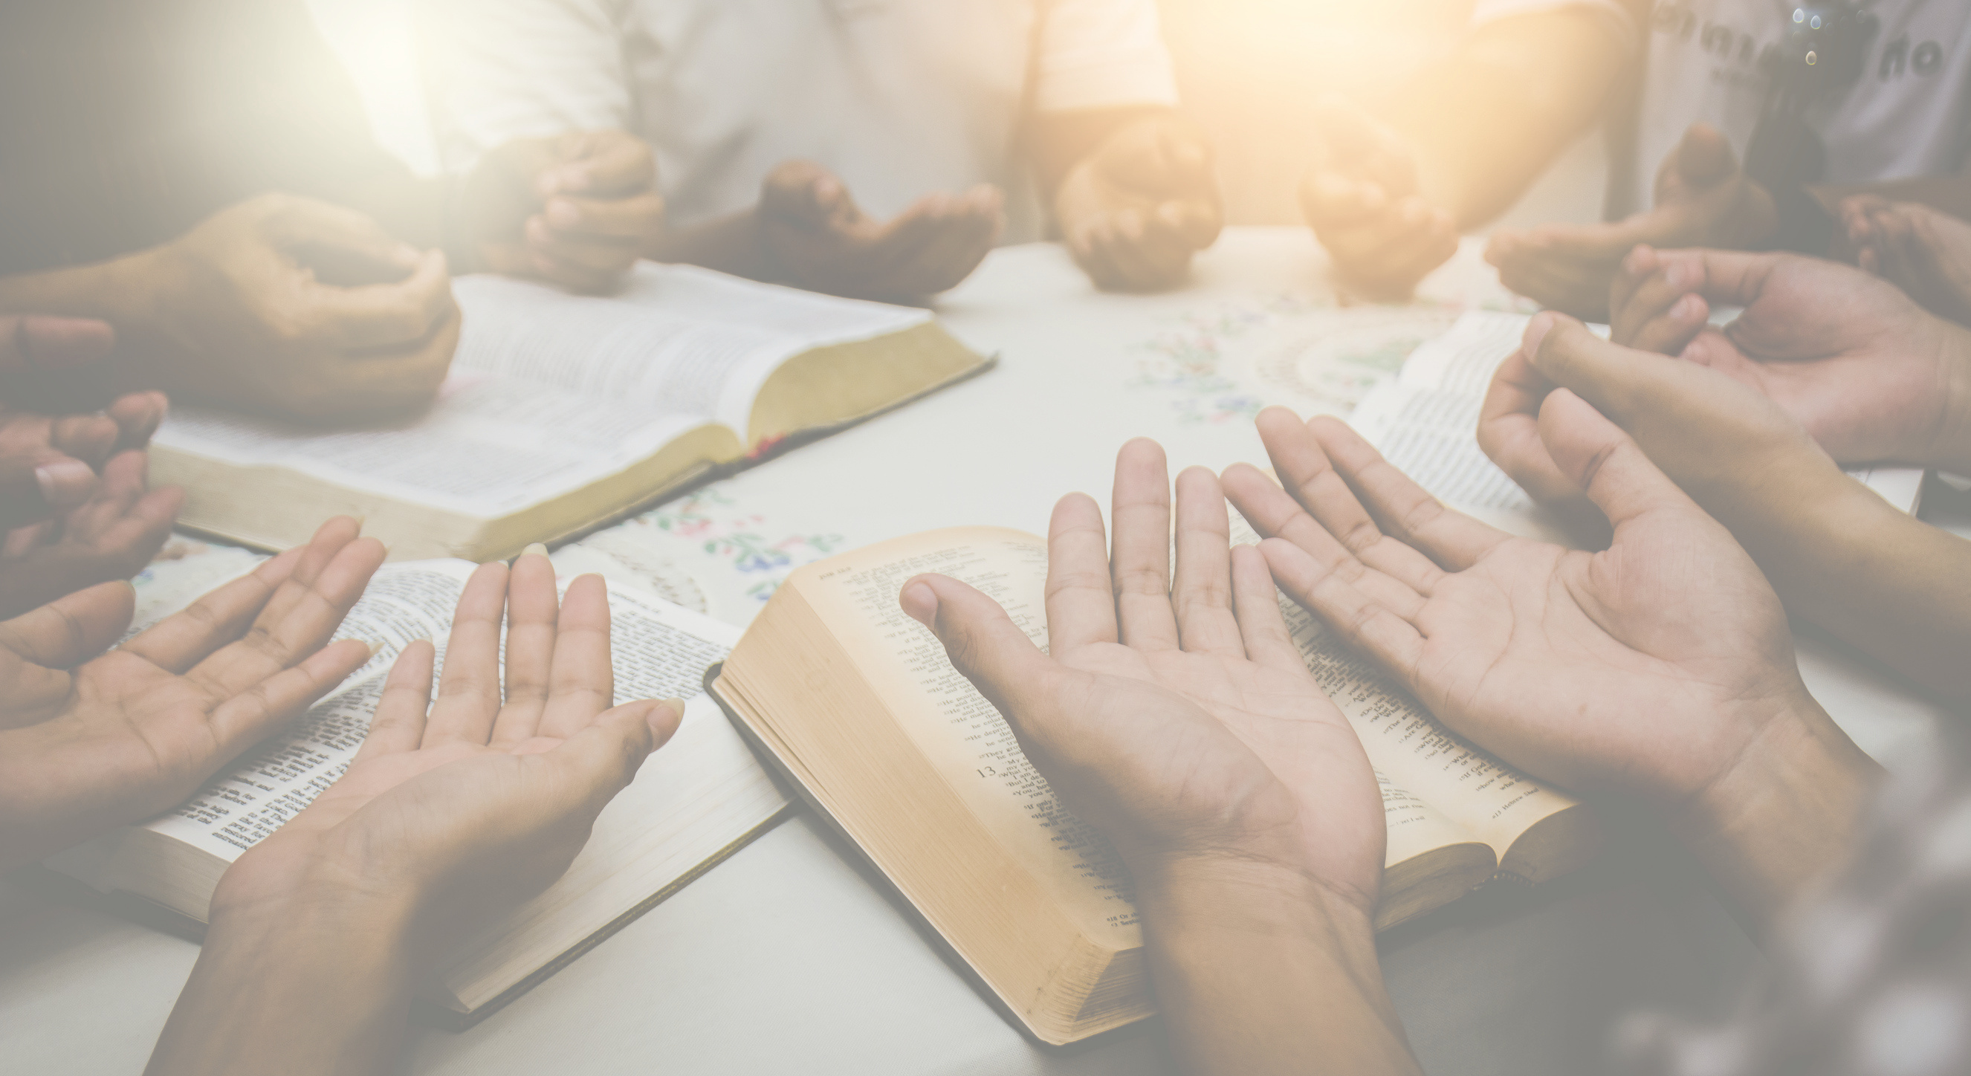
Isaiah 65:24
"It will also come to pass that before they call, I will answer; while they are still speaking, I will listen."
NASB
Notes:
Bible verse - Isaiah 65 v 24: "It will also come to pass that before they call, I will answer; while they are still speaking, I will listen."

Slide 4
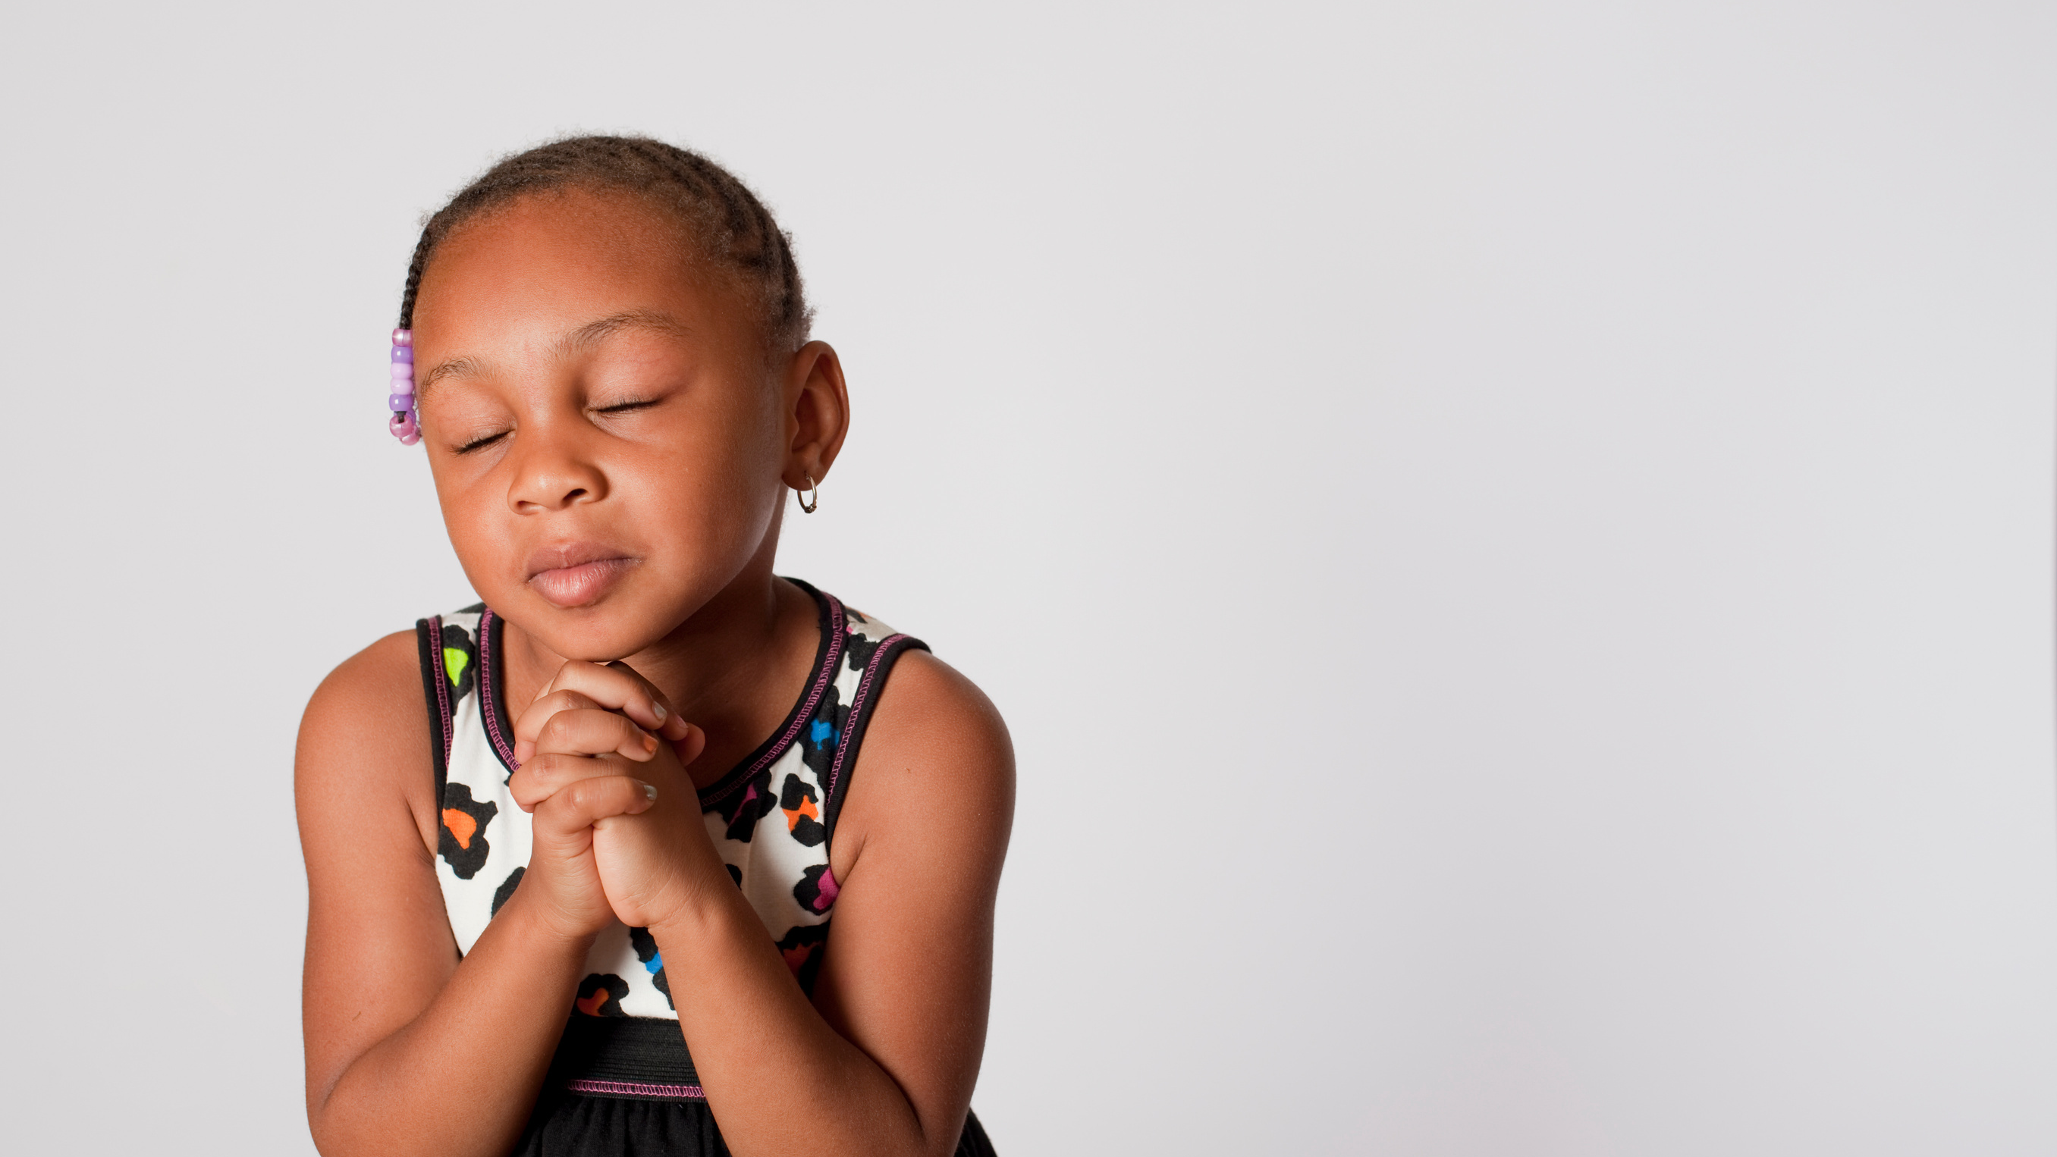
WHAT IS PRAYER?
Notes:
Take this time to open up discussion with the group, depending on their ages. Talk about the story - did they like it? Start with simple questions like,
What is Prayer?
Can you ask God for anything?
Do we still talk to God even though he already knows what we want?
Talk about the story:
Why was Helen so surprised when God answered Ruth's prayer? Would they have been like Helen or Ruth? Why?

Slide 5
Notes:
If it's appropriate, take some time now to pray to the God who loves and hears our prayers, even before we speak them.

Slide 6
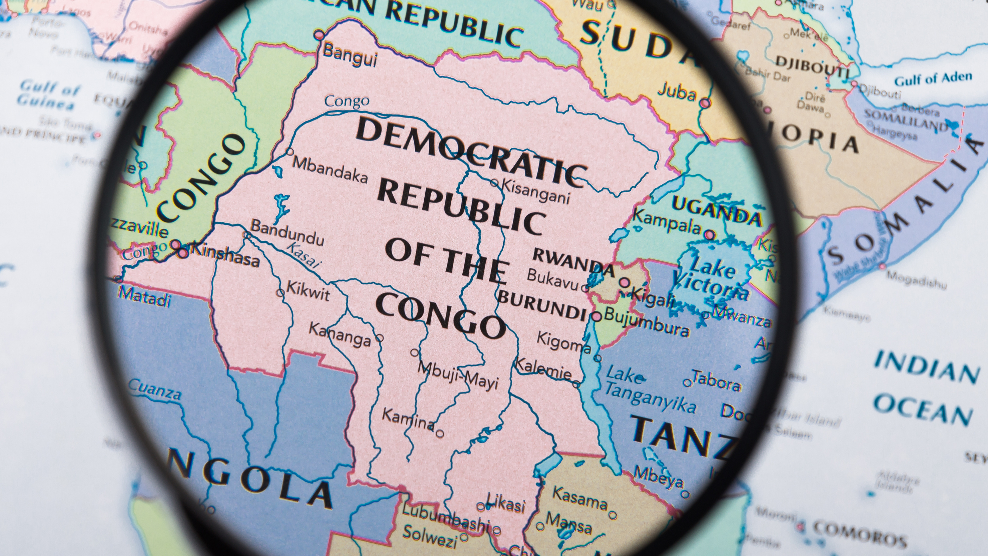
Notes:
Comfort International works in many countries in Africa, and one of those is the Democratic Republic of Congo, where this story took place! How much do you know about Congo?

Slide 7
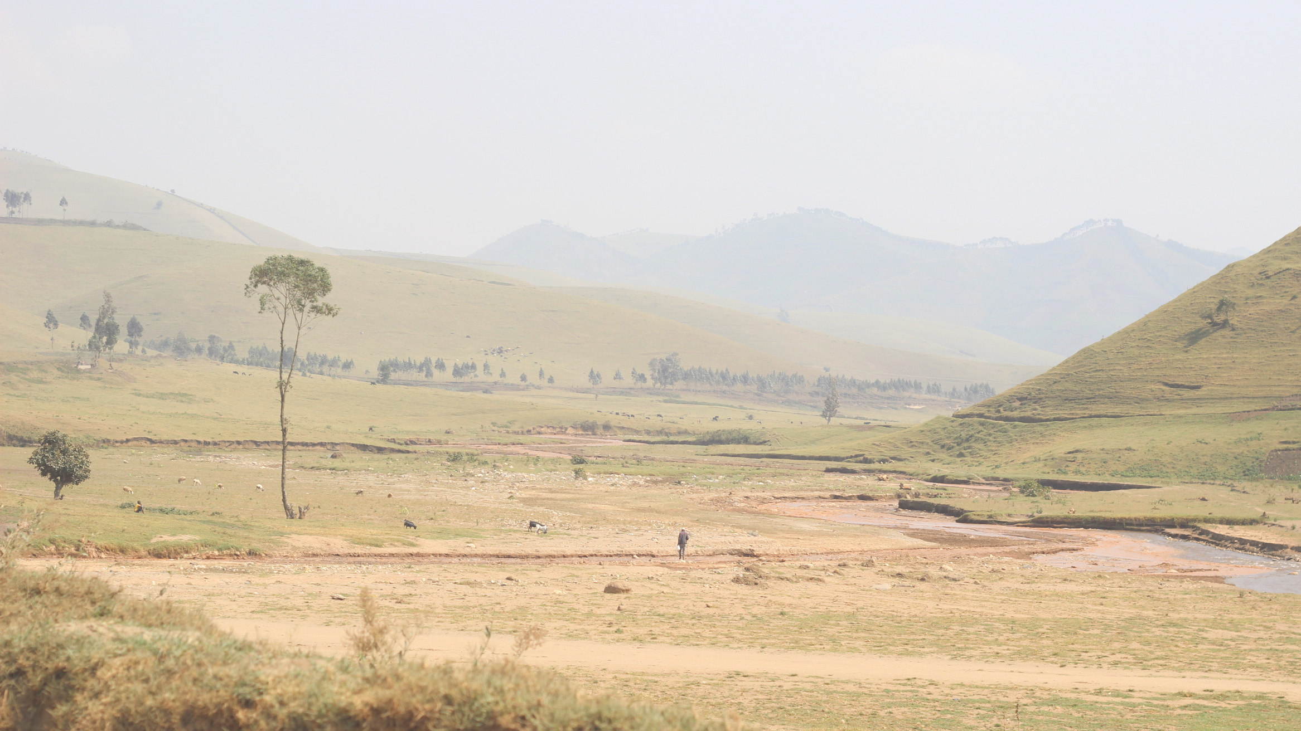
Where is the Democratic Republic of Congo?
A. Europe
B. Asia
C. Africa
Notes:
Where is the Democratic Republic of Congo?
A. Europe
B. Asia
C. Africa

Slide 8
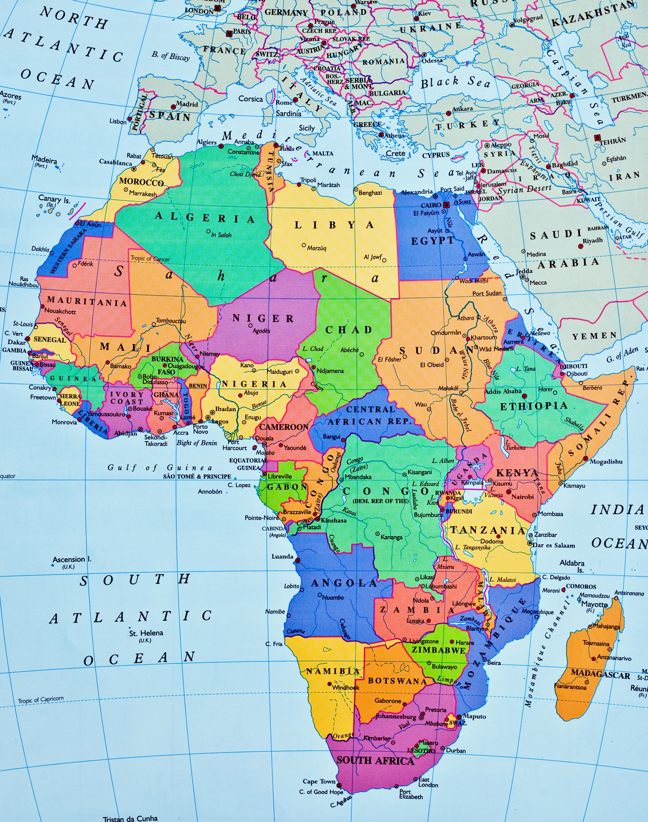
C. Africa!
Notes:
The answer is C. Africa! D. R. Congo is found right in the centre of Africa, and is bordered by other countries like South Sudan, Uganda, Rwanda, Burundi and Tanzania.

Slide 9
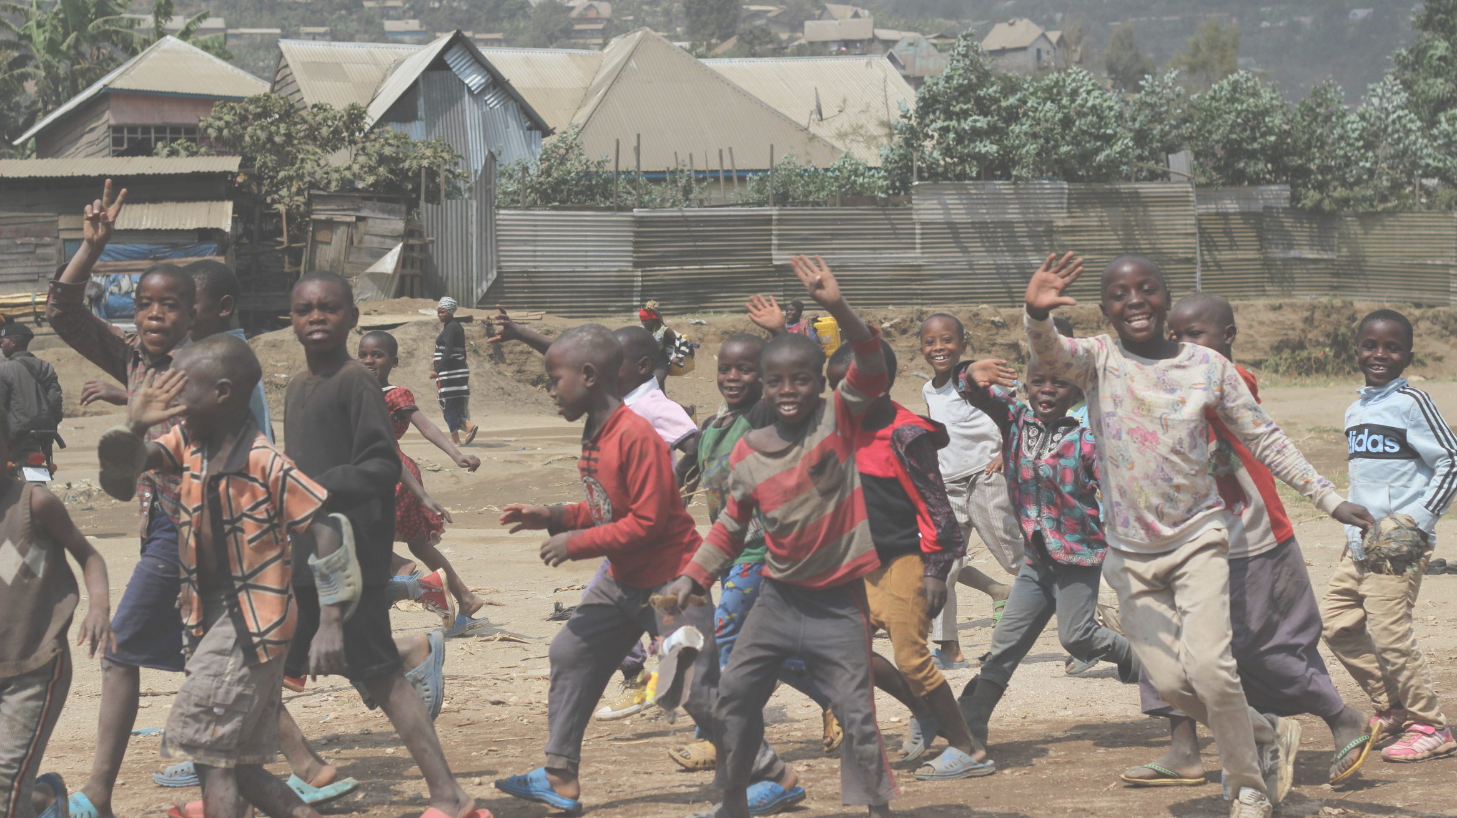
Which country has the biggest population?
A. United Kingdom
B. D. R. Congo
C. Rwanda
Notes:
Which country has the biggest population?
A. United Kingdom
B. D. R. Congo
C. Rwanda

Slide 10
B. D. R. Congo - with around 90 million people living there!
Notes:
B. D. R. Congo - with around 90 million people living there.
The UK has a population of around 67 million and Rwanda has a population of around 13 million.

Slide 11
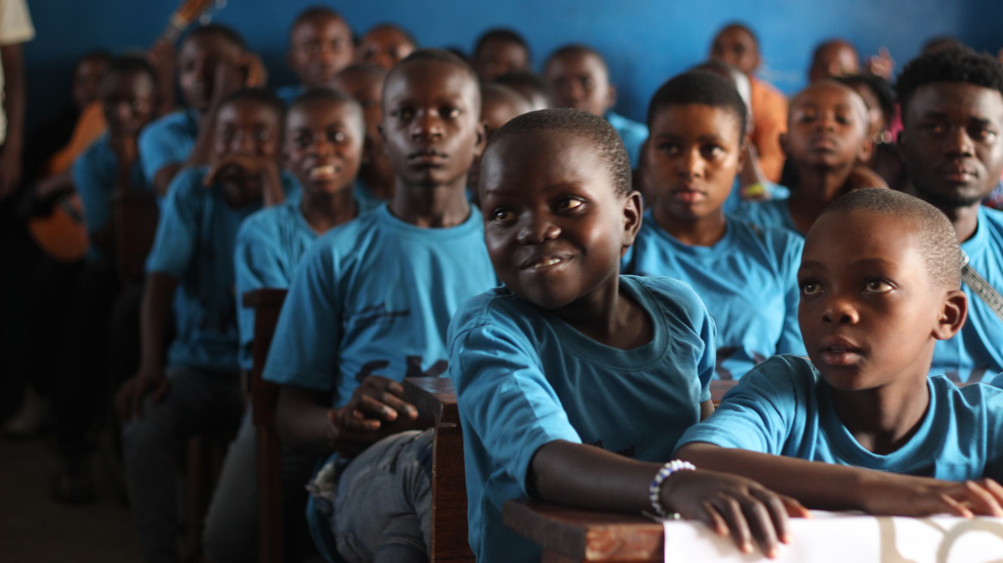
How many languages are spoken in
D. R. Congo?
A. 1
B. 30
C. 200
Notes:
How many languages are spoken in D.R. Congo?
A. 1
B. 30
C. 200

Slide 12
C. Over 200 languages and dialects are spoken in D.R. Congo!
Notes:
Over 200 languages and dialects are spoken in D.R. Congo! There are 5 main languages, which are French, Kikongo (Kituba), Lingala, Swahili, and Tshiluba, as well as many other dialects. Can you say anything in another language?

Slide 13
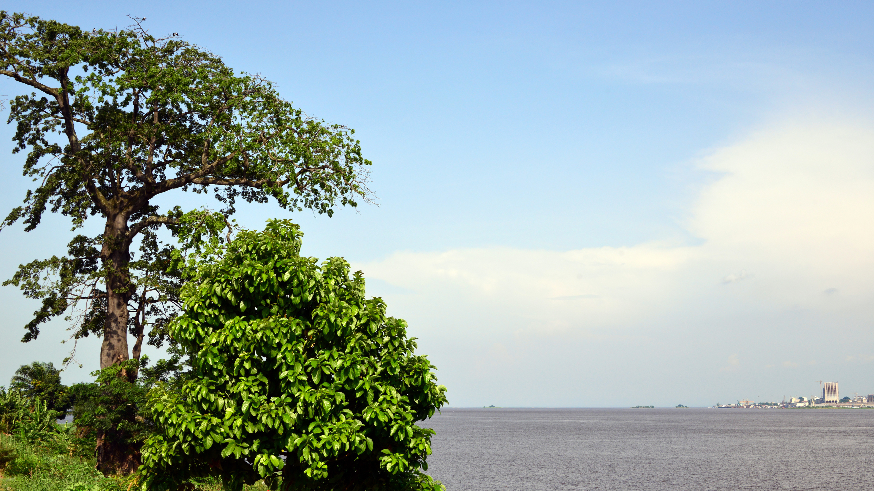
What animals can you find in
D.R. Congo?
Notes:
What kind of animals can you find in Congo?

Slide 14
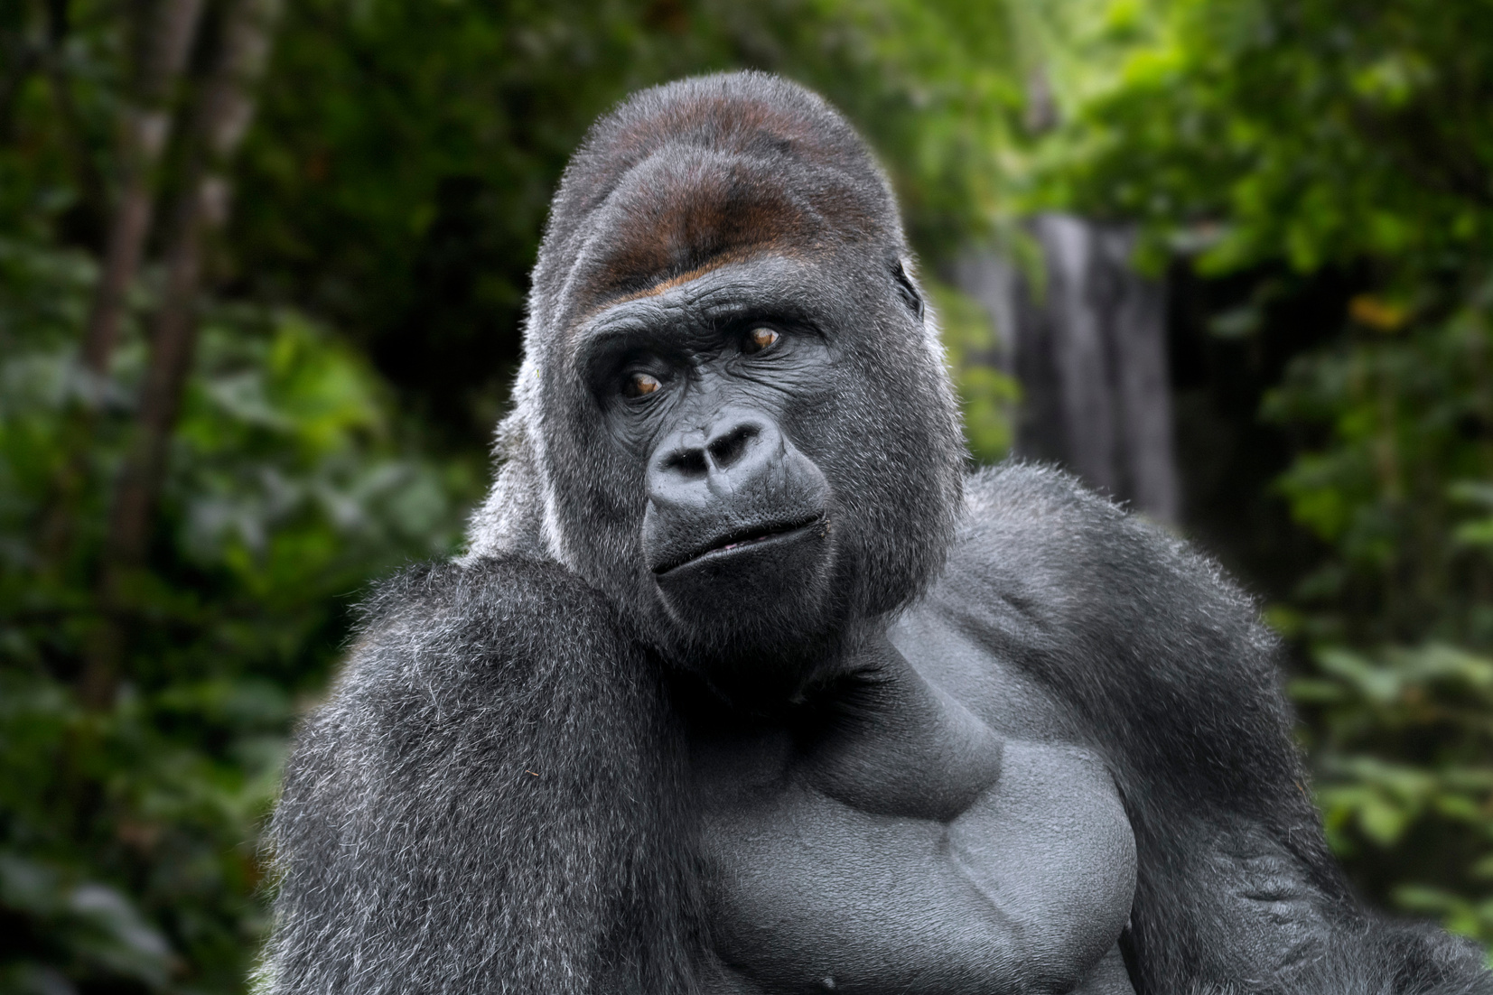
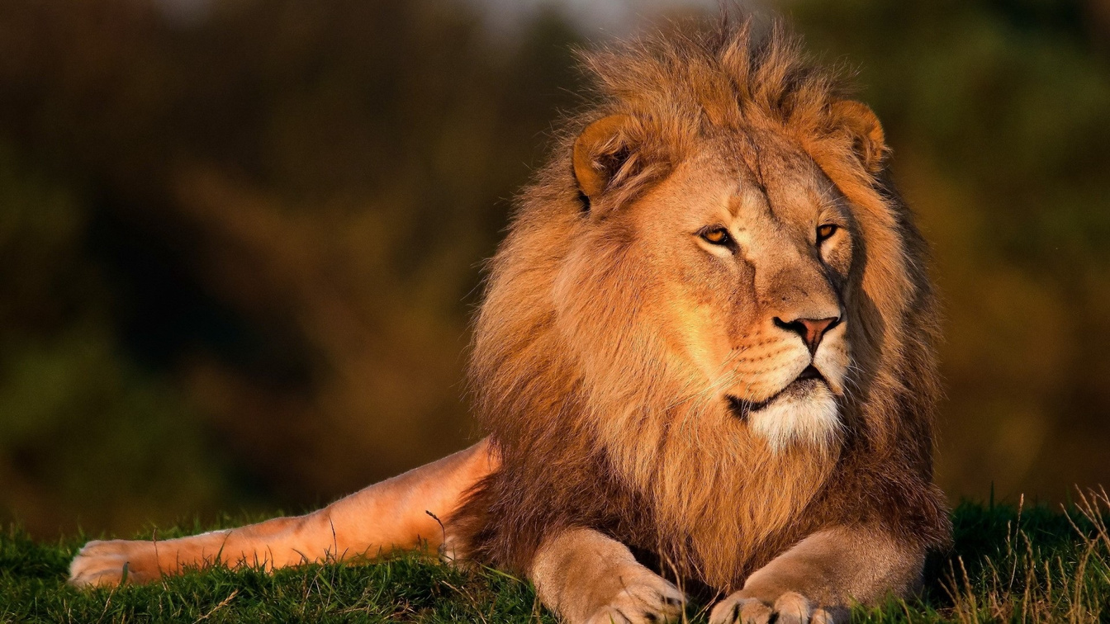
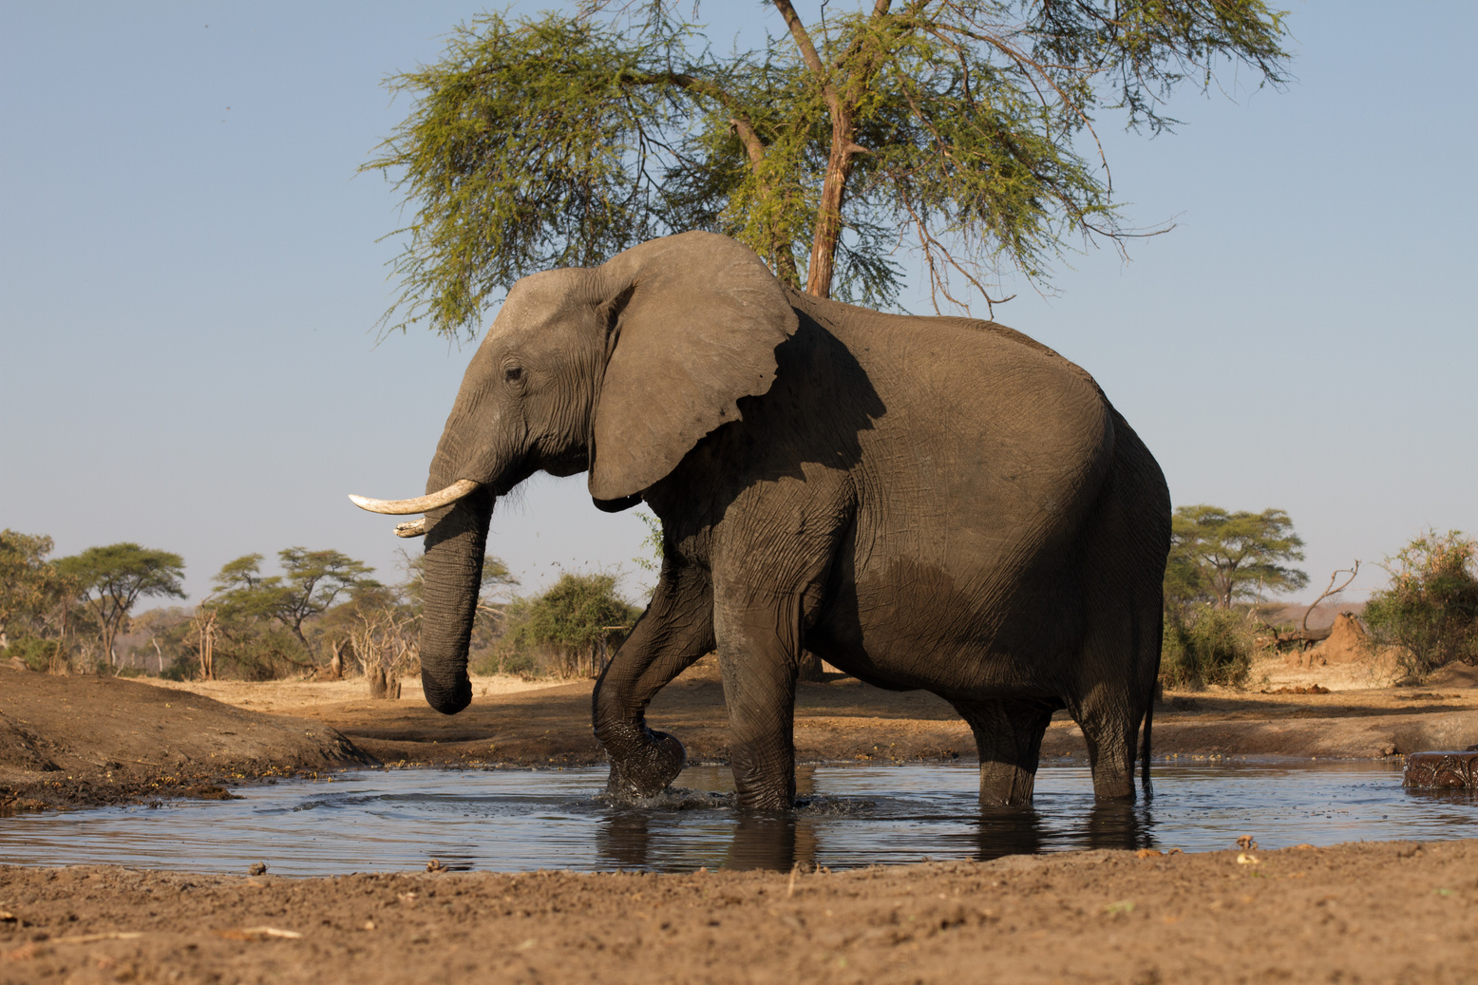
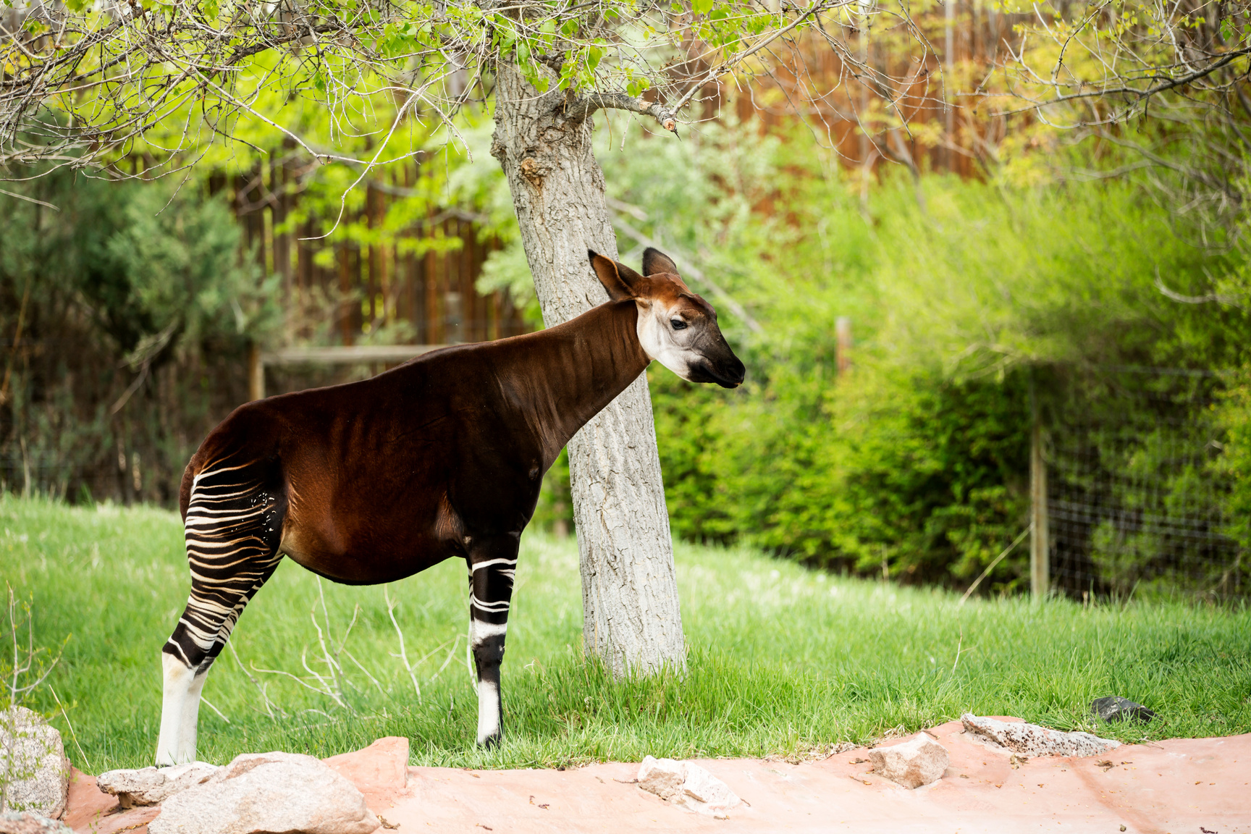
Notes:
There are thousands of species of mammals, birds and fish found in D.R. Congo. These include lions, rare mountain gorillas, African elephants, okapi (shown here).

Slide 15
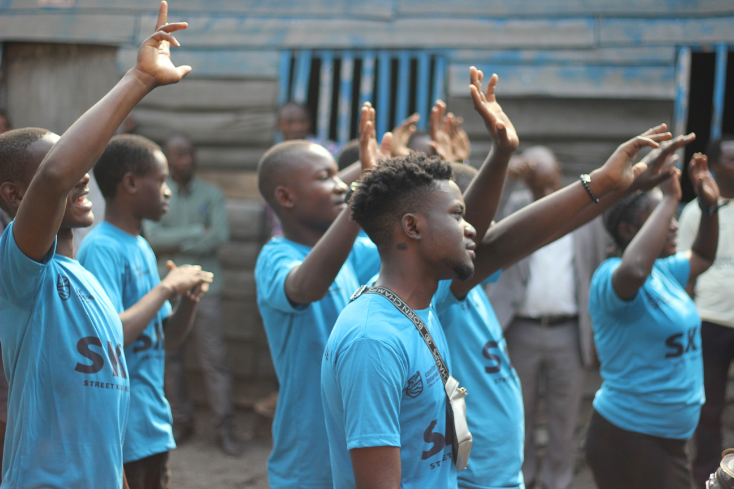
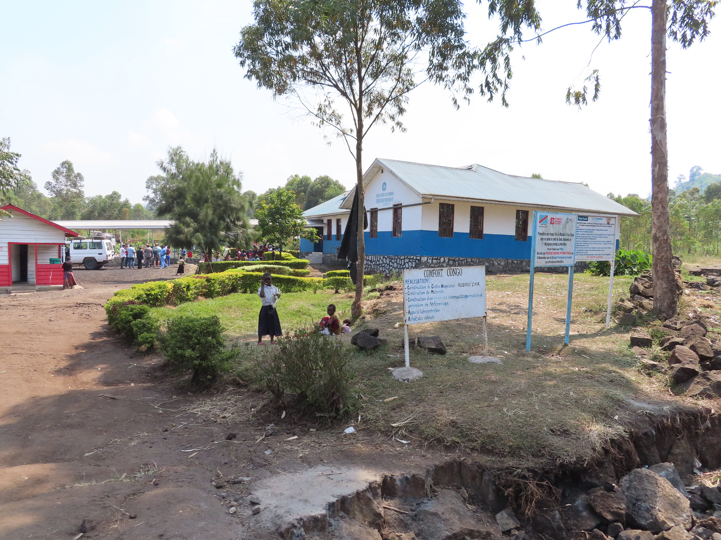
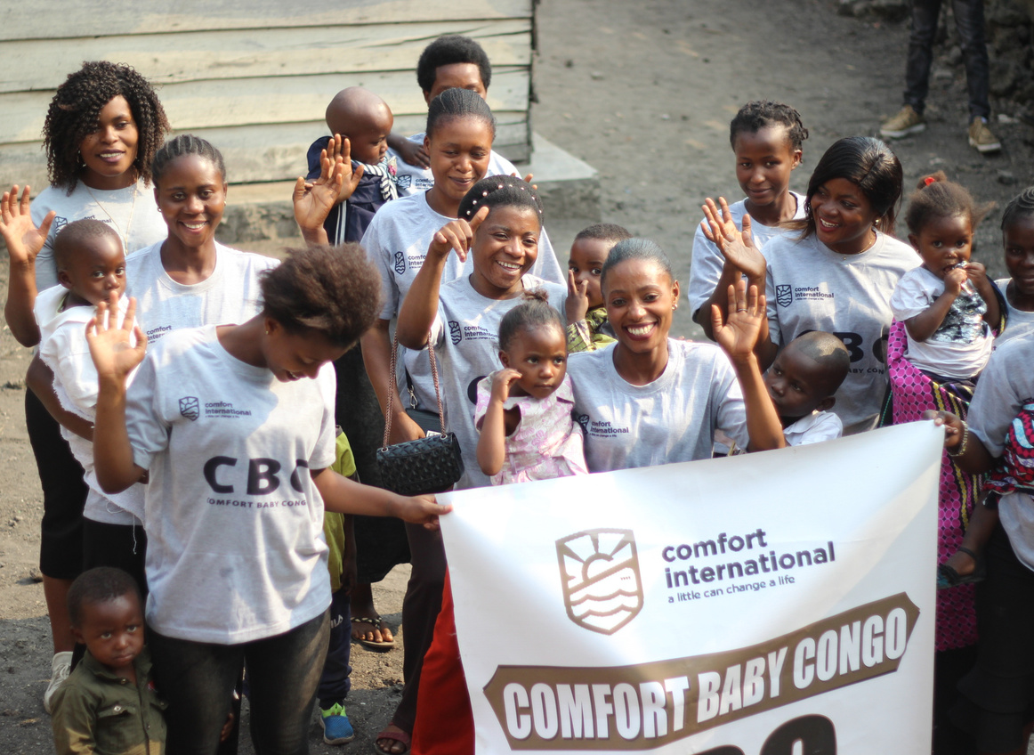
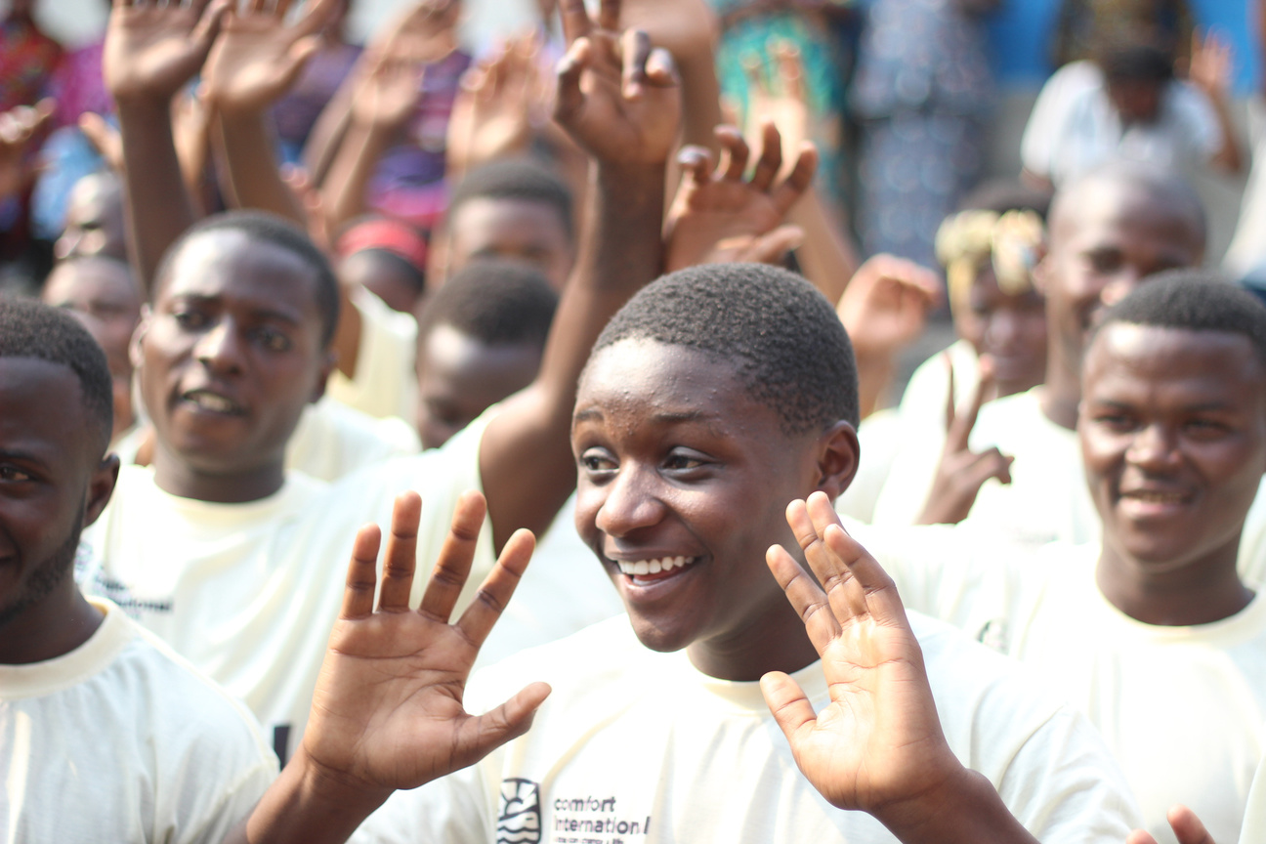
What are some of the things Comfort International does in D. R. Congo?
Notes:
What are some of the things Comfort International does in D. R. Congo?
Congo is one of the poorest countries in the world and there are many people and children there who need help. Comfort International is trying to work with those who are hungry, sick, sad or in need to bring the hope and love of Jesus to their lives. You can see some of our projects here.
From top right clockwise:
1. Street Kids Rescue Project - some young people in Congo don't have families or homes, so Comfort gives them a safe place to live, meals to eat and a community to be safe in.
2. Children of Liberty - Congo can be dangerous as there is a war going on there. Sometimes even children get forced into this war. Comfort rescues these children, gives them a safe place to live and works to tell them of their value and worth to Go.
3. Mums and babies - there are some Mums that need help to feed their babies and send them to school when they are grown up, so we have a Mums and babies groups for families that have had a difficult start to life.
4. This is the Central Hospital in Rusayo, in Congo. There are Congolese doctors and nurses working here, looking after mums and babies, just like Helen Roseveare, and looking after all the sick people that can't afford medical care. They are making sure that everyone in the area who needs medical care, gets it.

Slide 16
If you could send a package to the children of Congo, what would you put in it?
Notes:
What would your group send to the children of D R Congo? Encourage them to think about their material needs, like food, toothbrushes, clothes, shoes, things that we take for granted, but also to show them they are loved - maybe a card or verse or painted picture? (Note - This is purely an exercise, unfortunately we are unable to deliver packages to Congo like this. If your group would like to contribute, please consider a financial donation instead.)

Slide 17
Activity Time!
Notes:
If you have time use it to do a practical activity. For example:
-Make dolly & hot water bottle bunting and write the verse from Isaiah on them
-cut out a dolly or hot water bottle shape and write the verse on
Hot water bottle prayer wall - stick prayer requests on using post-its
-Using a square of brown paper, fold the corners into the centre making a parcel shape. Write the verse or prayers in the middle. Then tie with string to make a parcel.
See notes for resources

Slide 18
Asante Sana! Thanks for listening!
SCIO SC030369
comfortinternational.org
Notes:
Asante sana means thank you very much in Swahili - the main language spoken in Congo.

